Slide 1
Social Issue Management System
A microservices-based citizen complaint and issue resolution platform

Slide 2
Table of contents
01
02
03
04
05
06
Introduction
Project Architecture
Database Design
Technology Platform Used for Project
User Roles and Responsibilities
Future Extensions
& Conclusion

Slide 3
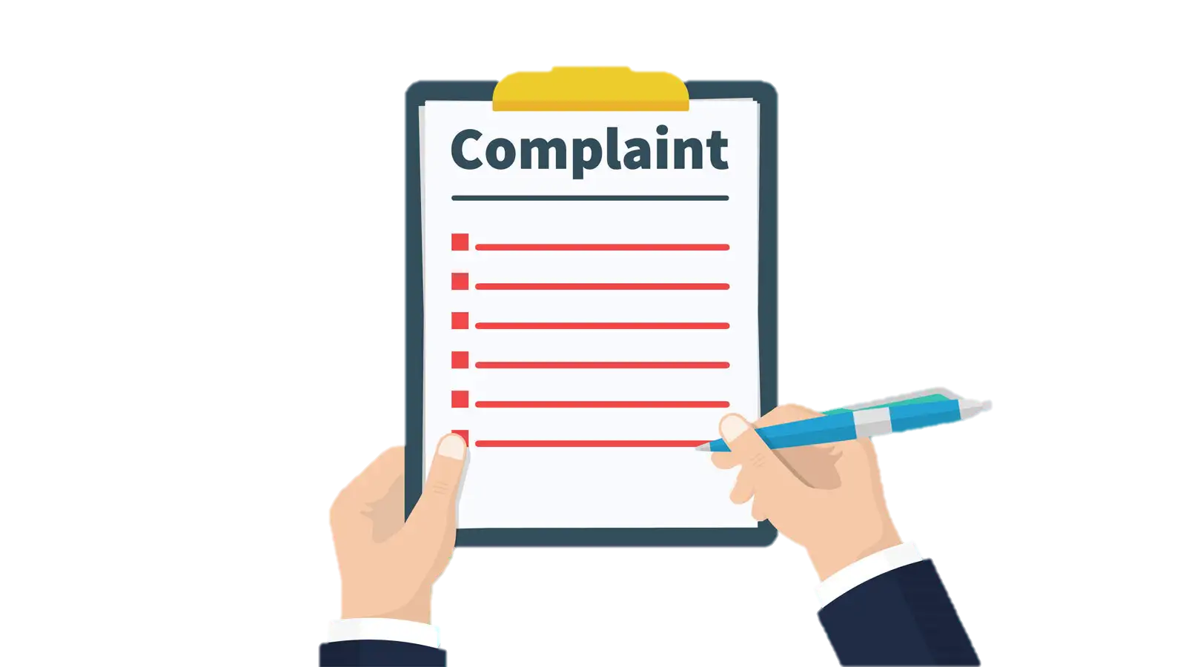
01
Introduction

Slide 4
Introduction
With rapid urbanization and increasing population in cities and towns, civic issues such as garbage disposal, road damage, water leakage, streetlight faults, and drainage problems are growing in number and urgency. Citizens often lack a centralized and effective system to report these problems and track their resolutions.
This project addresses this challenge by providing a centralized online complaint management platform where citizens can raise issues, authorities can assign and resolve them, and admins can monitor and manage the system’s efficiency. The platform improves transparency, accountability, and responsiveness in public issue management.

Slide 5
Objectives
Our aim
The goal
The aim is to develop a user-centric web-based application for lodging, tracking, and resolving civic complaints, ensuring better governance and improved public satisfaction.
Develop a modular, scalable, and secure web application using microservices architecture.
Enable citizens to register complaints with relevant details such as area, category, and description
Allow real-time tracking of complaint status

Slide 6

Need ?
In urban and rural areas alike, citizens frequently encounter public issues such as water supply problems, garbage collection delays, electricity failures, road damage, and other civic concerns. Traditionally, reporting these issues often involves visiting government offices, making phone calls, or relying on informal channels.
Existing methods face several challenges
Lack of transparency
Delayed resolution
Poor communication
Data loss

Slide 7
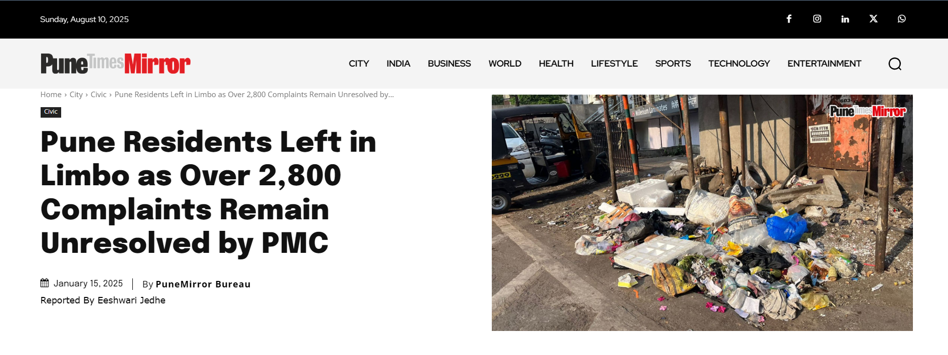
2,842
2,331
Pending Complaints
Exceeding their deadlines without resolution

Slide 8
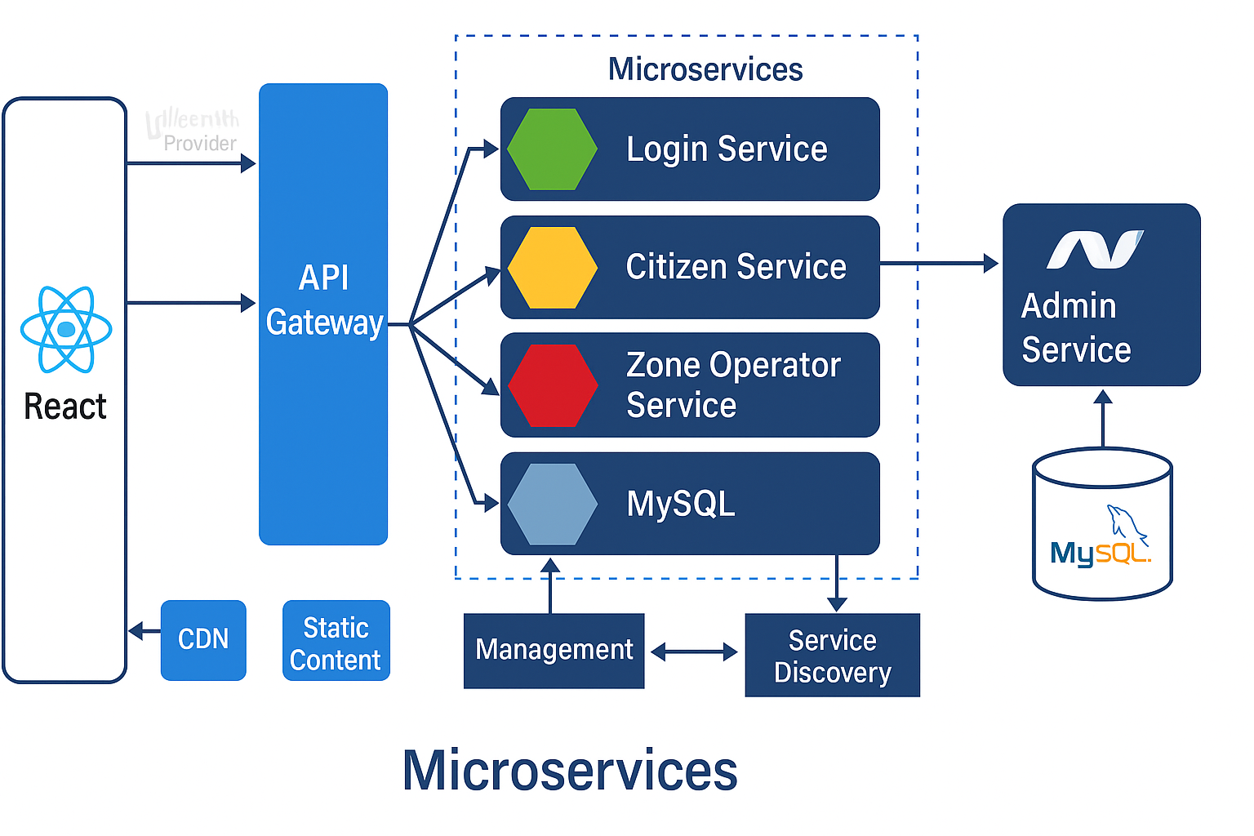
Project Architecture

Slide 9
Tables
Keys & Constraints
user, citizen, zone_operator, complaint_status, citizen_complaint, area, category
Database Design
Primary and Foreign Keys maintained
NOT NULL, FK constraints
Relationships
user -> citizen, operator, admin
citizen -> citizen_complaint
complaint_status -> citizen_complaint, operator

Slide 10




Technology Platform Used
Front End
Backend
Database
React Java (Spring Boot) .NET Core MySQL 8.0
Security: JWT, Spring Security
Reason for Choices:
Spring Boot/.NET ease REST API development
MySQL for relational structure
React for modular UI with fast rendering

Slide 11
Technology Platform Used
Front End
Backend
Database
React Java (Spring Boot) .NET Core MySQL 8.0
Security: JWT, Spring Security
Reason for Choices:
Spring Boot/.NET ease REST API development
MySQL for relational structure
React for modular UI with fast rendering

Slide 12
Technology Platform Used
Front End
Backend
Database
React Java (Spring Boot) .NET Core MySQL 8.0
Security: JWT, Spring Security
Reason for Choices:
Spring Boot/.NET ease REST API development
MySQL for relational structure
React for modular UI with fast rendering

Slide 13



User Roles and Responsibilities
Roles | Responsibilities |  | Use Cases
ADMIN | Manage users, zones, and complaints, generates reports |  | Add/Delete user, assign operator, Add/Delete Area & Add/Delete Issue
CITIZEN | Register, view and track complaints |  | File complaint, view status, Submit feedback
ZONE OPERATOR | Update status of complaints, i.e. resolve complaints |  | View Complaints, Change complaint status & Generate Reports

Slide 14
User Roles and Responsibilities
Roles | Responsibilities |  | Use Cases
ADMIN | Manage users, zones, and complaints, generates reports |  | Add/Delete user, assign operator, Add/Delete Area & Add/Delete Issue
CITIZEN | Register, view and track complaints |  | File complaint, view status, Submit feedback
ZONE OPERATOR | Update status of complaints, i.e. resolve complaints |  | View Complaints, Change complaint status & Generate Reports

Slide 15
User Roles and Responsibilities
Roles | Responsibilities |  | Use Cases
ADMIN | Manage users, zones, and complaints, generates reports |  | Add/Delete user, assign operator, Add/Delete Area & Add/Delete Issue
CITIZEN | Register, view and track complaints |  | File complaint, view status, Submit feedback
ZONE OPERATOR | Update status of complaints, i.e. resolve complaints |  | View Complaints, Change complaint status & Generate Reports

Slide 16
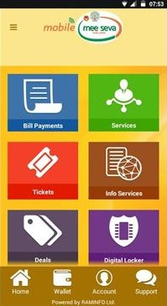
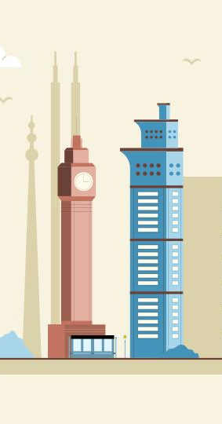
Future Extensions
Integration with mobile application
Expanding all over geographical areas
SMS/email notifications for status updates
Feedback & rating system after complaint resolution

Slide 17
Challenges & Learning
Challenges
Microservices integration
Entity mapping across services
Learnings
Spring Security, JWT, Entity Framework
Real-world architecture design
Experience
Effective teamwork, version control
Confidence in building full-stack systems

Slide 18
CONCLUSION
The Social Issue Management System (SIMS) efficiently uses a microservices architecture combining Spring Boot, .NET Core, ReactJS, and MySQL to streamline issue reporting and resolution. The modular design—Login, Citizen, and Zone Operator Services in Spring Boot, and Admin Service in .NET—ensures scalability, security (via JWT), and ease of maintenance.
We gained hands-on experience in cross-technology integration, secure authentication, and API Gateway management. In the future, SIMS can be enhanced with real-time notifications, GIS mapping, and AI-based issue prioritization, making it a more powerful civic engagement tool.

Slide 19
Thank You!
Harshwardhan Dhole 250243020036
Kshitij More 250243020057
Parag Suryavanshi 250243020061
Soham Tanavade 250243020098

